Slide 1
Hibernate
What is Hibernate?
How it’s work?
What is required to implement it?
Complete Example

Slide 2
What is Hibernate?
Simply, instead of creating Entities(Tables) using MySql Language, in Hibernate we use pure java to do that.
By doing this, we reduce the work required to modify the table attributes and constrains
Each entity(table) would be represented in a class.
For manipulating data, we create a class that has functions to do the desired queries.

Slide 3
How it’s work?
Java
MySql Server
Request
Connection
class
Database
Responds

Slide 4
What is required to implement it?
Java side
Connection class
To establish connection to MySql server.
Entity(Table) class
To create the entity(table).
Data Access layer(DAL) class
To manipulate the data, and generate queries.
MySql Server side
Create database
To create Tables inside it through Java Hibernate.

Slide 5
Complete Hibernate Example
@ To do list :
Create dynamic Web Project, using Maven.
Include the required libraries.
Create the main 3 Hibernate framework classes
Create Starter class

Slide 6
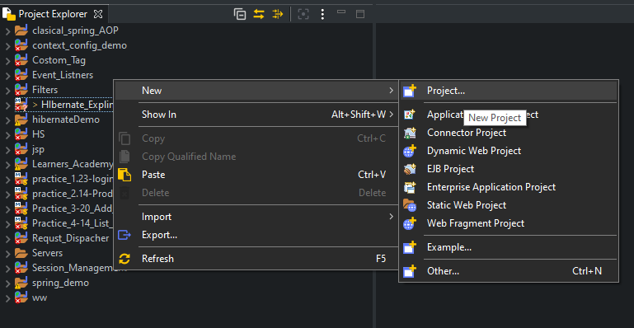
Create dynamic Web Project, using Maven
Open new project window

Slide 7
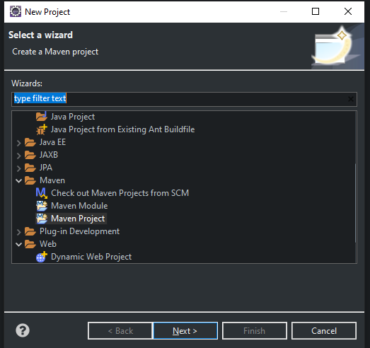
Create dynamic Web Project, using Maven
1
Click on Maven Project
Click on Next
2

Slide 8
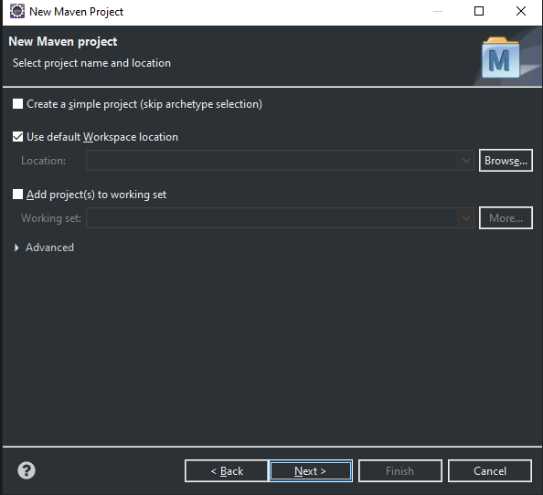
Create dynamic Web Project, using Maven
Click on Next

Slide 9
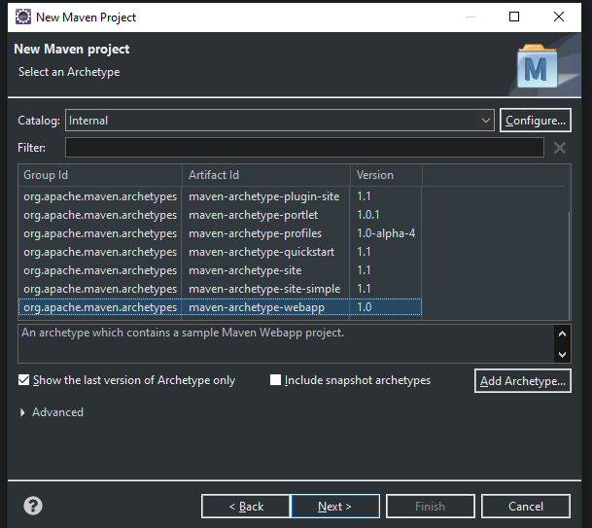
Create dynamic Web Project, using Maven
1
Scroll Down and select
maven-archetype-webapp
2
Click on Next

Slide 10
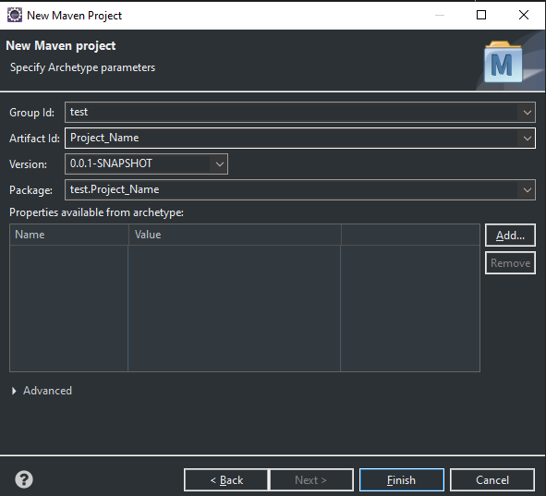
Create dynamic Web Project, using Maven
1
Type any thing here
2
Type the Project Name
3
Click on Finish

